Slide 1
Unit 5

Slide 2
Properties of L-C immitance
Impedence or admittance is the ratio of odd to even or even to odd polynomials.
The poles and zeros are simple and lie on the jw axis.
The poles and zeros interlace on the jw axis.
The highest powers of numerator and denominator must differ by unity; the lowest powers also differ by unity.
There must be either a zero or a pole at the origin and infinity.

Slide 3
Properties of R-C impedences
Poles and zeros lie on the negative real axis, and they alternate.
The singularity nearest to (or at) the origin must be a pole whereas the singularity nearest to (or at) σ=-∞ must be zero.
The residues of the poles must be real and positive.

Slide 4
Properties of R-L impedences
Poles and zeros of an R-L impedance or R-C admittance are located on the negative real axis, and they alternate.
The singularity nearest to (or at) the origin is zero. The singuarity nearest to (or at) s = -∞ must be a pole.
The residues of the poles must be real and negative.

Slide 5
Synthesis of certain R-L-C functions
When, positive real function is given, and it is found that the function is not synthesizable by using two kinds of elements only, R-L-C driving-point functions can be synthesized.
A continued fraction expansion or a partial fraction expansion be tried first.

Slide 6



2 Methods to synthesize
Partial Fraction
Continued Fraction

Slide 7

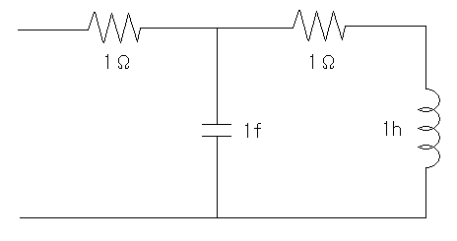

Continued Fraction Expansion

Slide 8
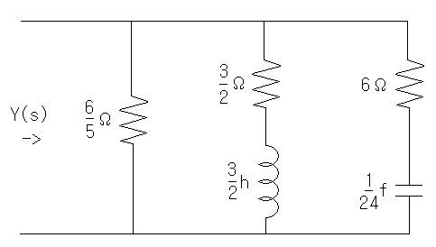


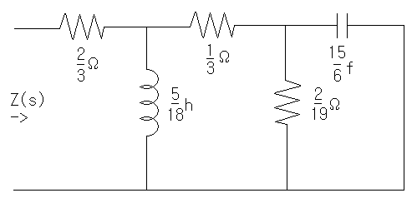
Partial Fraction Expansion

Slide 9

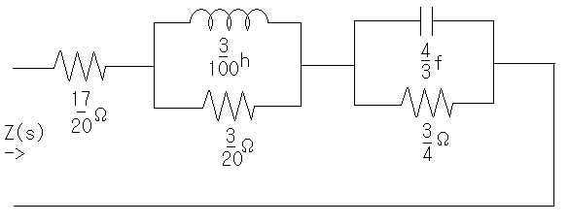
Practice Problem
Synthesize following impedence function

Slide 10
Synthesis of one-port networks with two kinds of elements
11.1 Properties of L-C immittance functions
11.2 Synthesis of L-C driving-point immittances

Slide 11
Contents
Properties of L-C immittance functions
  Properties
  Examples of immittance and non-immittance
  functions
Synthesis of L-C driving-point immittance
  Synthesis of L-C circuit
  Examples of synthesis

Slide 12
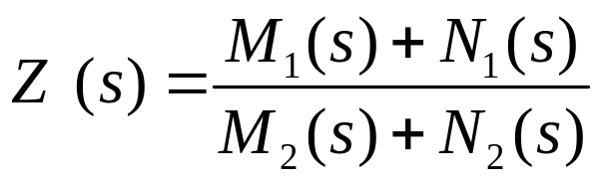
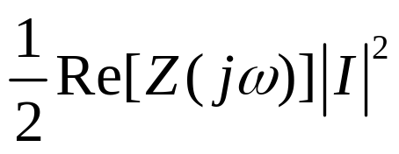
Property 1. L-C immittance function
1. Z_{LC} (s) or Y_{LC} (s) is the ratio of odd to even or even to odd
polynomials.
  Consider the impedance Z(s) of passive one-port network.
  (M is even N is odd)
  As we know, when the input current is I, the average power dissipated by one-port network is zero:
Average Power= =0
(for pure reactive network)

Slide 13
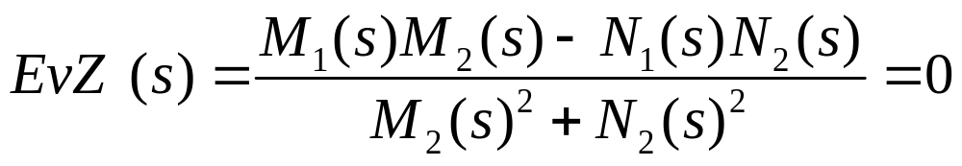
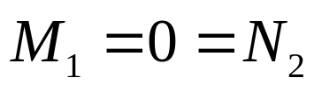

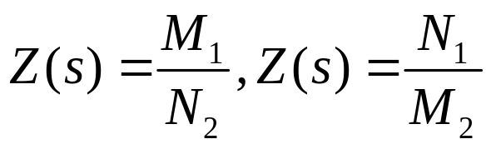
OR
Z(s) or Y(s) is the ratio of even to odd or odd to even!!

Slide 14
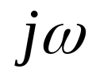
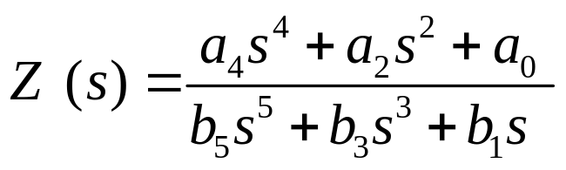
Property 2. L-C immittance function
2.The poles and zeros are simple and lie on the axis.
  Since both M and N are Hurwitz, they have only imaginary roots, and it follows that the poles and zeros of Z(s) or Y(s) are on the imaginary axis.
  Consider the example

Slide 15

In order for the impedance to be positive real → the coefficients must be real and positive.
Impedance function cannot have multiple poles or zeros on the
axis.
The highest powers of the numerator and the denominator polynomials can differ by, at most, unity.
Ex) highest order of the numerator : 2n -> highest order of the denominator can either be 2n-1 (simple pole at s= ) or
the order can be 2n+1 (simple zero at s= ).

Slide 16

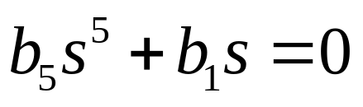
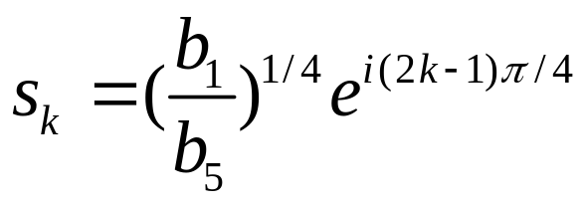
Property 3. L-C immittance function
3.The poles and zeros interlace on the axis.
X(w)
+2
+4
0
+1
+3
Highest power: 2n -> next highest power must be 2n-2
They cannot be missing term. Unless?
if → s=0,

Slide 17
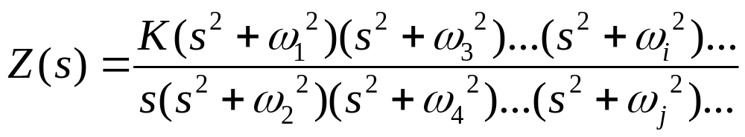
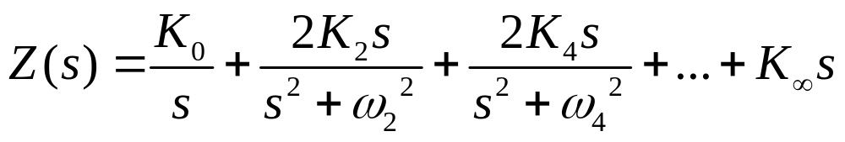
We can write a general L-C impedance or admittance as
Since these poles are all on the jw axis, the residues must be real and positive in order for Z(s) to be positive real .
S=jw → Z(jw)=jX(w) (no real part)

Slide 18
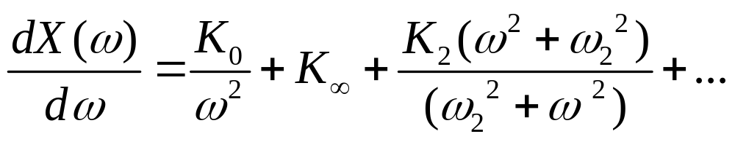
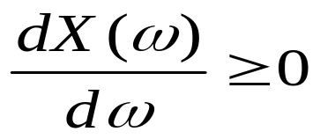
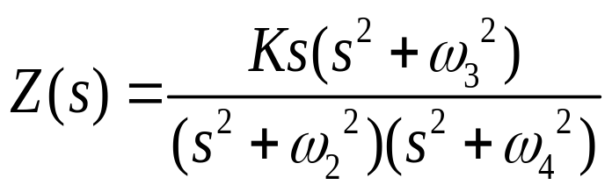
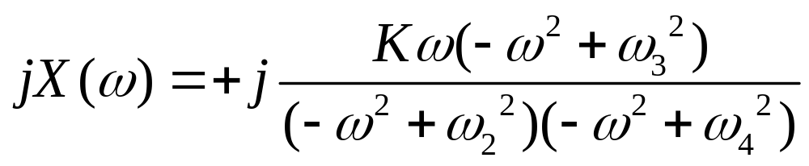
Since all the residues Ki are positive, it is eay to see that for an L-C function
Ex)
X(w)
w3
w2
w
0
w4

Slide 19
Properties 4 and 5. L-C immittance function
The highest powers of the numerator and denominator must differ by unity; the lowest powers also differ by unity.
There must be either a zero or a pole at the origin and infinity.

Slide 20

Summary of properties
1. or Y_{LC} (s) is the ratio of odd to even or even to odd polynomials.
2. The poles and zeros are simple and lie on the jw axis
3. The poles and zeros interlace on the jw axis.
4. The highest powers of the numerator and denominator must differ by unity; the lowest powers also differ by unity.
5. There must be either a zero or a pole at the origin and infinity.

Slide 21
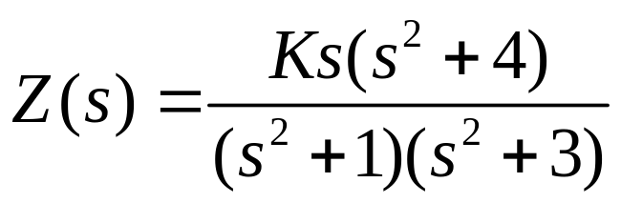
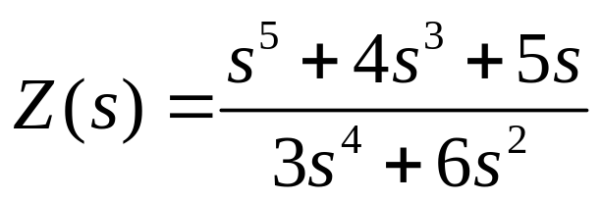
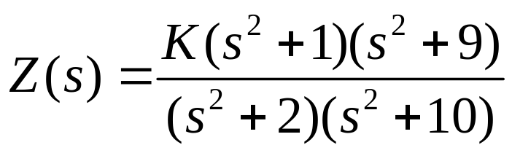
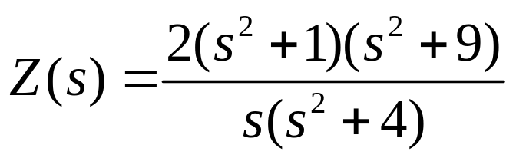
Examples

Slide 22

11.2 Synthesis of L-C Driving point immittances
L-C immittance is a positive real function with
poles and zeros on the jw axis only.
The synthesis is accomplished directly from the partial
fraction .
F(s) is impedance -> then the term :
capacitor of 1/K farads
the K(infinite)s is an inductance of K(infinite) henrys.

Slide 23
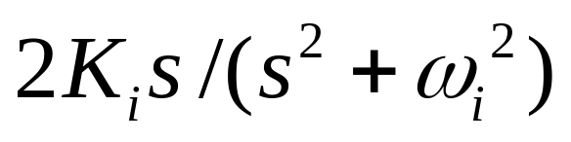
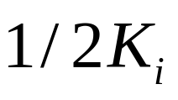
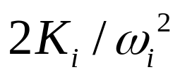
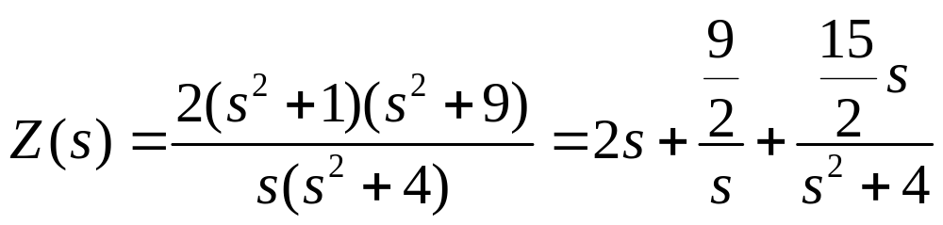
For Z(s) partial fraction
Is a parallel tank capacitance and inductance.
,
2/15f
2h
2/9 f
15/8 h

Slide 24
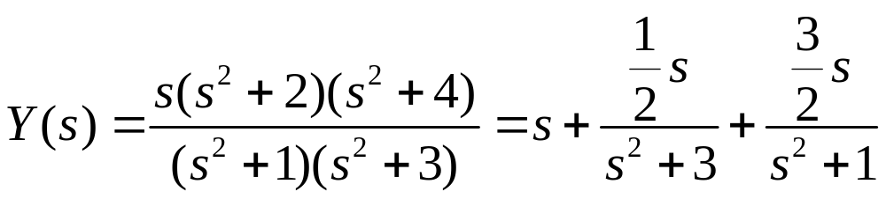
For Y(s) partial fraction
In admittance
2h
2/3 h
1f
→ Y(S)
1/6 f
3/2 f

Slide 25
Another methodology
Using property 4 “The highest powers if numerator and denominator must differ by unity; the lowest powers also differ by unity.”
  Therefore, there is always a zero or a pole at s=infinite .
  suppose Z(s) numerator:2n ,denominator:2n-1
  this network has pole at infinite. -> we can remove this pole by removing an impedance L ₁ s
Z₂ (s) = Z(s) - L ₁ s
Degree of denominator : 2n-1 numerator:2n-2
  Z₂ (s) has zero at s=infinite.
  Y₂ (s) =1/ Z₂ (s) , → Y₃ (s) = Y₂ (s) - C₂ s

Slide 26
This infinite term removing process continue until the remainder is zero.
Each time we remove the pole, we remove an inductor or capacitor depending upon whether the function is an impedance or an admittance.
→ Final synthesized is a ladder whose series arms are inductors and shunt arms are capacitors.

Slide 27
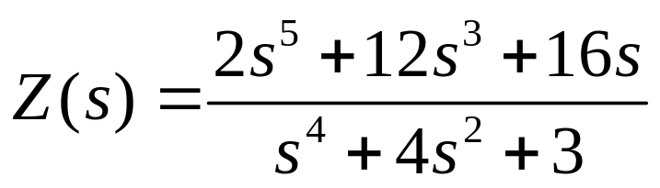
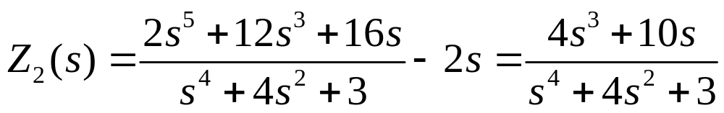
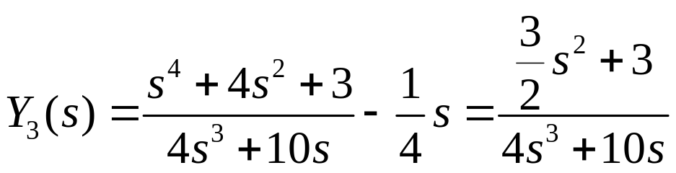
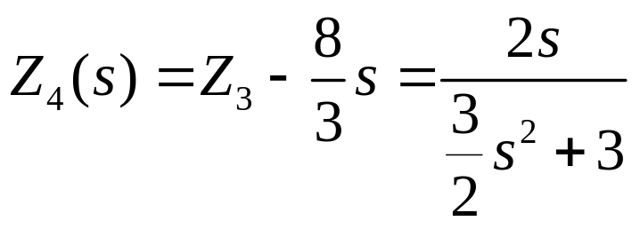
2h
2h
8/3 h
2/3 h
1/4 f
3/4 f

Slide 28
This circuit (Ladder) called as Cauer
because Cauer discovered the continues fraction method.
Without going into the proof of the statement m in can be said that both the Foster and Cauer form gice the minimum number of elements for a specified L-C network.

Slide 29
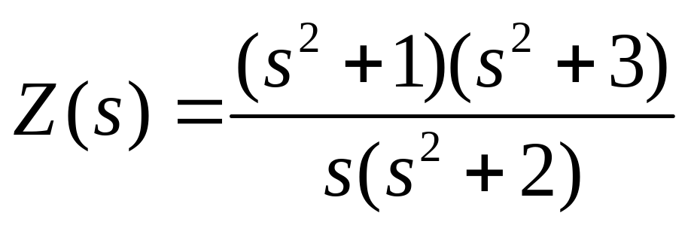
Example of Cauer Method
2/3 f
2/25 f
5/4 h
5 h

